Slide 1


Climate Change Impacts
Adapting to Climate Change
Global Climate Change EART21202 – Week 8
Dr Thomas Bannan
Thomas.Bannan@Manchester.ac.uk

Slide 2
Q1.
How does climate change impact human health? Which populations are most vulnerable?

Slide 3

Q1. Answer
How does climate change impact human health? Which populations are most vulnerable?
Heat-related illnesses: for example, more heatwaves can increase deaths among older people and outdoor workers.
Diseases spread by insects: Climate change contributes to the spread of insect borne diseases; for instance, rising temperatures expand mosquito habitats, increasing the transmission of illnesses like malaria.
Air pollution: Smoke from wildfires and ozone pollution can make respiratory problems worse.
Mental health: Climate change impacts mental health by increasing anxiety and stress, especially for those facing displacement due to rising sea levels, extreme weather, or environmental change.
Most at risk: Those most vulnerable to climate change include low-income households and populations in developing countries, who often face greater exposure and fewer resources to adapt.

Slide 4
Q2.
What are the key climate risks facing the UK? How should policymakers adapt?

Slide 5
Q2. Answer
What are the key climate risks facing the UK? How should policymakers adapt?
This can be found in the IPCC worldwide adaptation slide.
Flooding: Rising sea levels and heavier rainfall increase flood risks.
  Adaptation: Strengthen flood defences, improve drainage systems, and implement natural flood management (e.g., wetland restoration).
Heatwaves: More frequent extreme heat events (think about the UK stats I showed in the lecture as examples)
  Adaptation: Increase tree cover, improve building insulation, and develop heatwave emergency plans.
Agriculture: Droughts threaten crops and food production.
  Adaptation: Invest in drought-resistant crops, improve water management, change in fertiliser use, and support sustainable farming techniques.
Policy measures: Urban areas face rising climate risks in many cases.
  Adaptation: Expand green spaces, enforce climate-resilient building practices, and invest in early warning systems for extreme weather.

Slide 6
Q3.
How might changes in temperature, precipitation, and extreme weather affect food availability and global agricultural productivity?

Slide 7
Q3. Answer
How might changes in temperature, precipitation, and extreme weather affect food availability and global agricultural productivity?
Examples from the lectures:
Crop yields: Decreased in heat sensitive regions (e.g., maize and wheat losses in South Asia). Not all areas will see yield reductions, some may see increases.
Drought & flooding: Affect planting cycles, farming practices and soil quality.
Food security: Increased food prices, malnutrition risks in particularly affected areas
Adaptation strategies: Climate-resilient farming, crop diversification, agroforestry. Lots covered in week 10.
Can any more be added?

Slide 8
Q4.
How does climate change disproportionately affect vulnerable populations, such as Indigenous communities, low-income households, and developing nations?

Slide 9
Q4. Answer
How does climate change disproportionately affect vulnerable populations, such as Indigenous communities, low-income households, and developing nations?
Financial burden: Poorer communities have fewer resources to recover from climate disasters and often least well able to adapt
Relocation risks: Coastal and island communities face displacement. This could also be due to economics (e.g. water quality affecting fishing productivity)
Health disparities: Poor air quality and extreme heat disproportionately affect low-income urban populations.
Policy solutions: Climate frameworks, equitable adaptation funding (see the Paris Agreement for more details)

Slide 10
Q5.
What are the key differences between RCP2.6, RCP4.5, RCP6.0, and RCP8.5? What policy choices can push us toward the lower emissions scenarios?

Slide 11
Q5. Answer
What are the key differences between RCP2.6, RCP4.5, RCP6.0, and RCP8.5? What policy choices can push us toward the lower emissions scenarios?
RCP2.6: Requires drastic emission cuts, net-zero targets, aggressive mitigation (Paris Agreement goal), but note there is now an RCP1.9 as mentioned in the lecture
RCP4.5 & RCP6.0: Intermediate scenarios with partial mitigation; likely warming of 2-3°C.
RCP8.5: High emissions, worst-case/business as normal scenario (warming >4°C).
Policy solutions: Renewable energy adoption, energy production, reforestation (see lecture 9 for mitigations for a range of economic sectors)

Slide 12
Q6.
How do increasing global temperatures contribute to extreme weather events such as hurricanes, heatwaves, and flooding? Give specific examples.

Slide 13
Q6. Answer
How do increasing global temperatures contribute to extreme weather events such as hurricanes, heatwaves, and flooding? Give specific examples.
Heatwaves: More frequent and intense due to rising average temperatures
Hurricanes & Storms: Warmer oceans provide more energy for storms
Flooding: Increased precipitation intensity leads to flash floods
Overall, climate change amplifies extreme events, necessitating better forecasting and resilience planning.
Can you find examples of this?

Slide 14
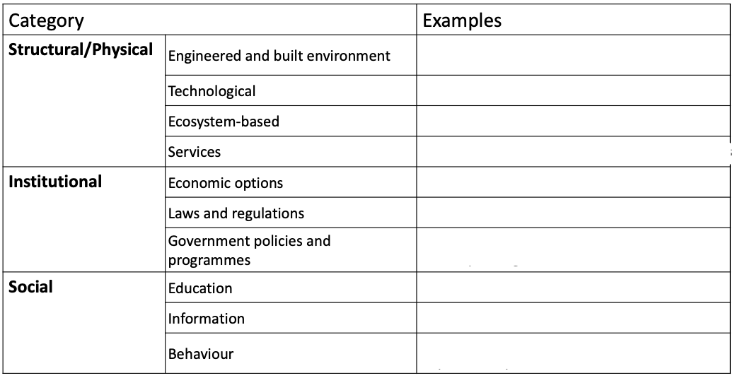
Q7.
Provide some possible examples of adaptation strategies relating to each category….

Slide 15
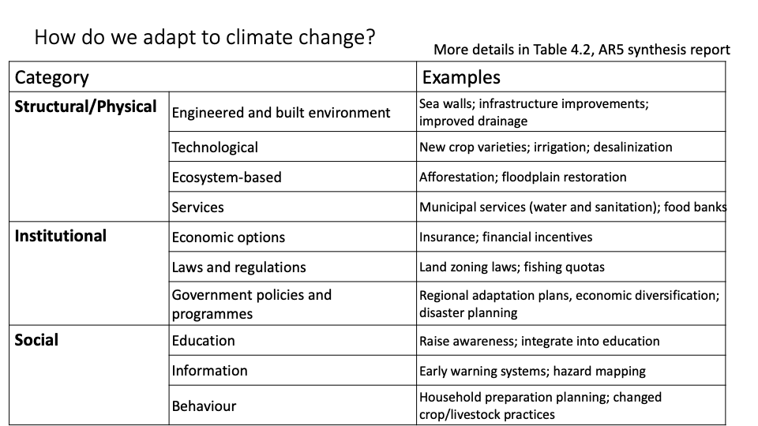
Q7. Answer
Provide some possible examples of adaptation strategies relating to each category….

